Slide 1
Networking & Logging in KMM
Oliver Muthomi - @muthomi

Slide 2

Logging
Why should you care Log Levels
Logging In KMM
Notes:
There are not many pure kotlin loggers - L4J, SLFJ, Flogger Options are to create own logging framework or use existing meh loggers
Log Levels
Verbose - Application events: button clicks, text box states, etc - on device
Debug - Localized section. Eg working on a new feature and want to investigate behaviour - can push on edge cases
Info - General information: action was taken, screen was openned - stream
Warn - Handled erexeptions: eg: network failures, missing config files, permissions revokes
Error - upheld exeptions:
Critical - Things not supposed to happen: Eg incompatibility with OS version,
Logging libraries for KMM = Klogger, Napier Apollo GraphQl

Slide 3
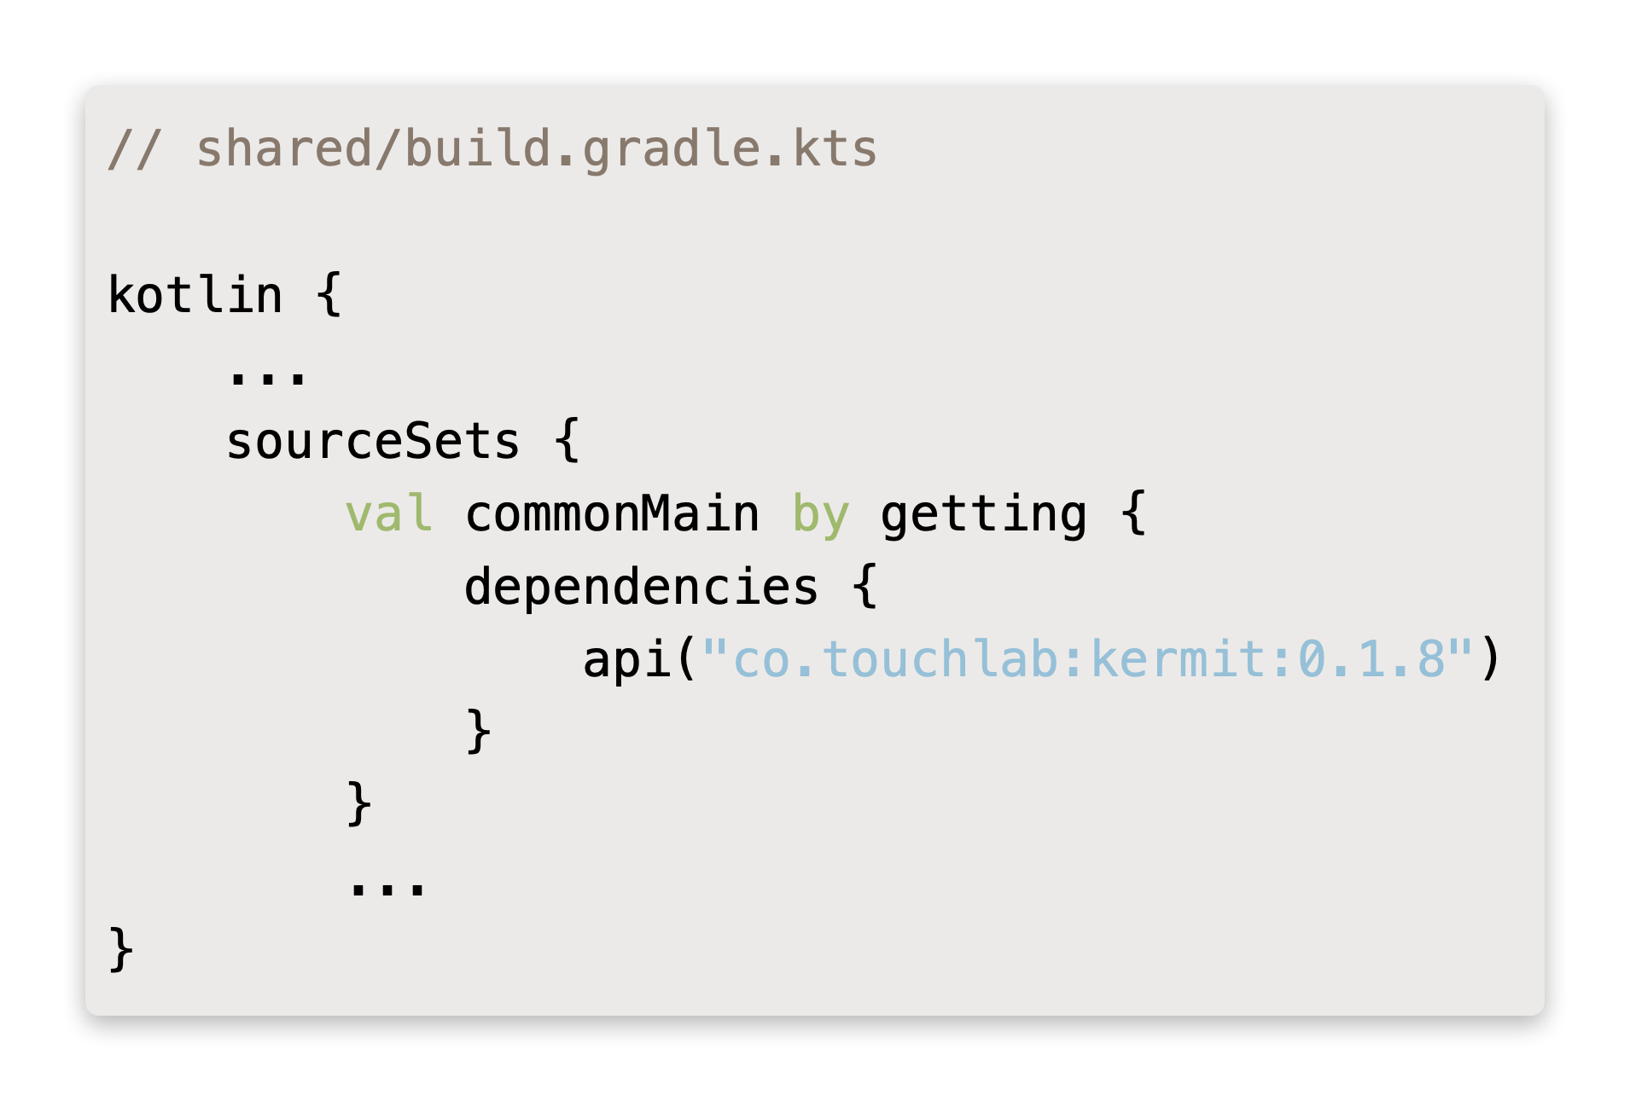
Logging With Kermit
Add kermit dependency
https://github.com/touchlab/Kermit

Slide 4
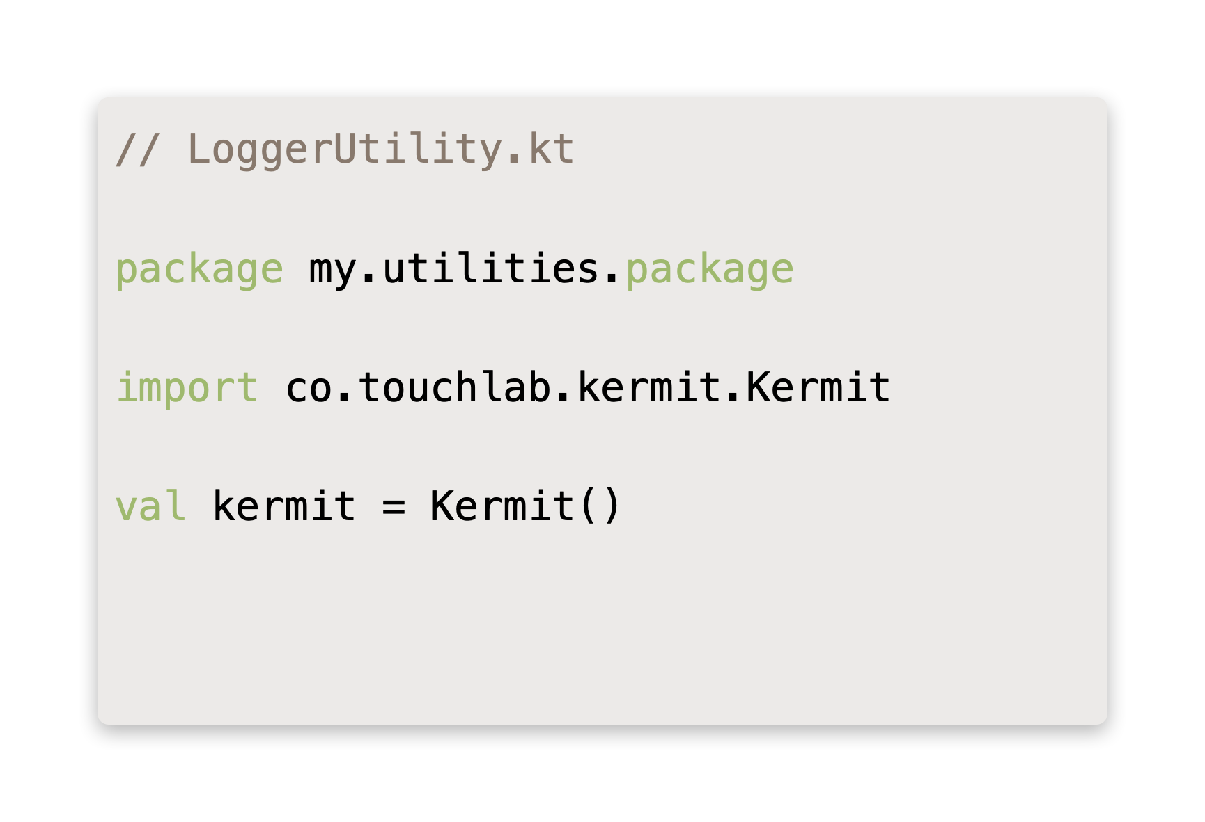
Logging With Kermit
Create / Customize Logger
https://github.com/touchlab/Kermit

Slide 5
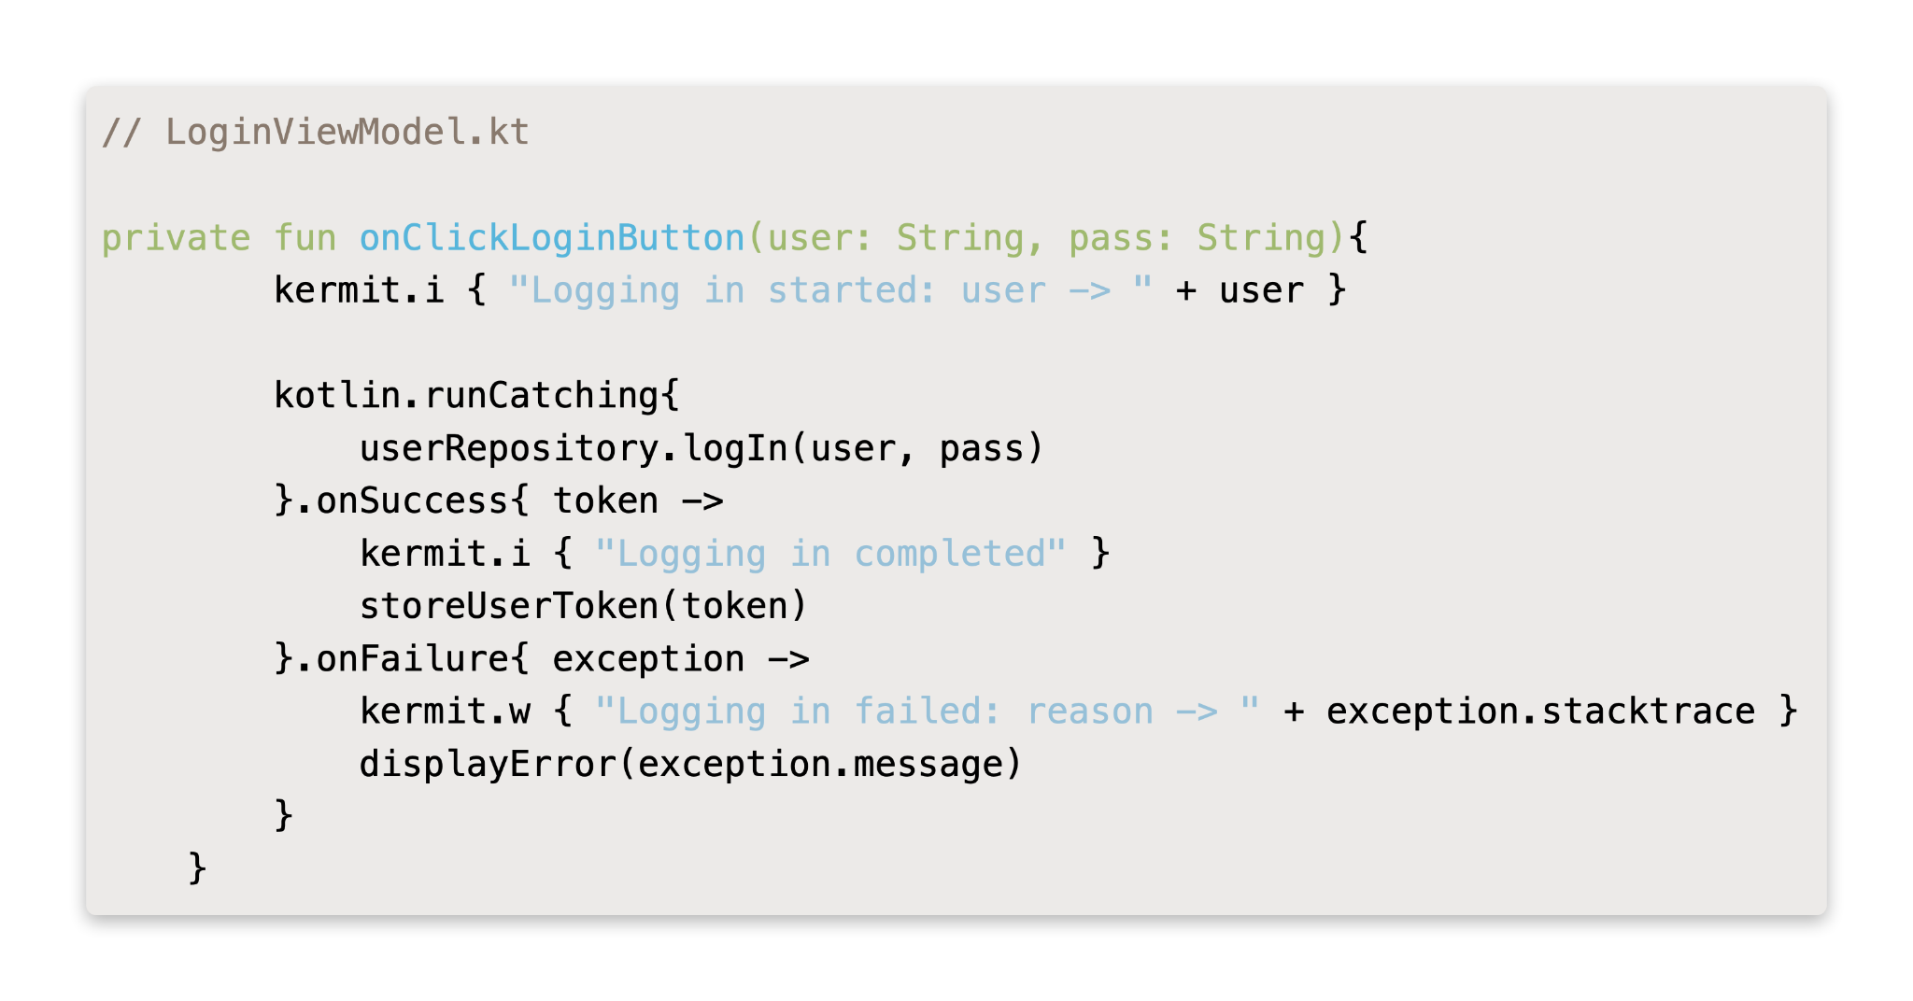
Logging With Kermit
Log Events
https://github.com/touchlab/Kermit

Slide 6
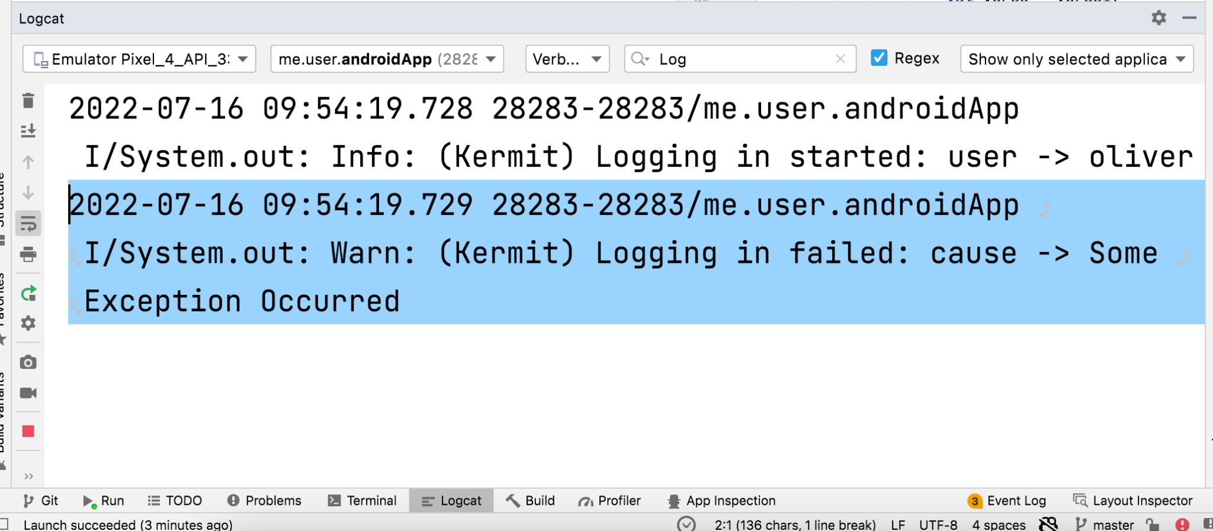
Logging With Kermit
Log Streaming
https://github.com/touchlab/Kermit

Slide 7

Networking
Why network is important
Why not retrofit ¯\_(ツ)_/¯
KTor
Testing
Notes:
There are not many pure kotlin loggers - L4J, SLFJ, Flogger Options are to create own logging framework or use existing meh loggers
Log Levels
Verbose - Application events: button clicks, text box states, etc - on device
Debug - Localized section. Eg working on a new feature and want to investigate behaviour - can push on edge cases
Info - General information: action was taken, screen was openned - stream
Warn - Handled erexeptions: eg: network failures, missing config files, permissions revokes
Error - upheld exeptions:
Critical - Things not supposed to happen: Eg incompatibility with OS version,

Slide 8
Types of Networking Events
Rest
01
Stream Events
02
GraphQl
03

Slide 9
Limitations Of Reftrofit (& Others)
Dependence On Platform APIs & Libraries
Java Classes
Notes:
Platform libraries
Eg, Volley - Logging, Obfuscation
Java Classes
Eg Retrofit , Okhttp - Contain Java Code

Slide 10
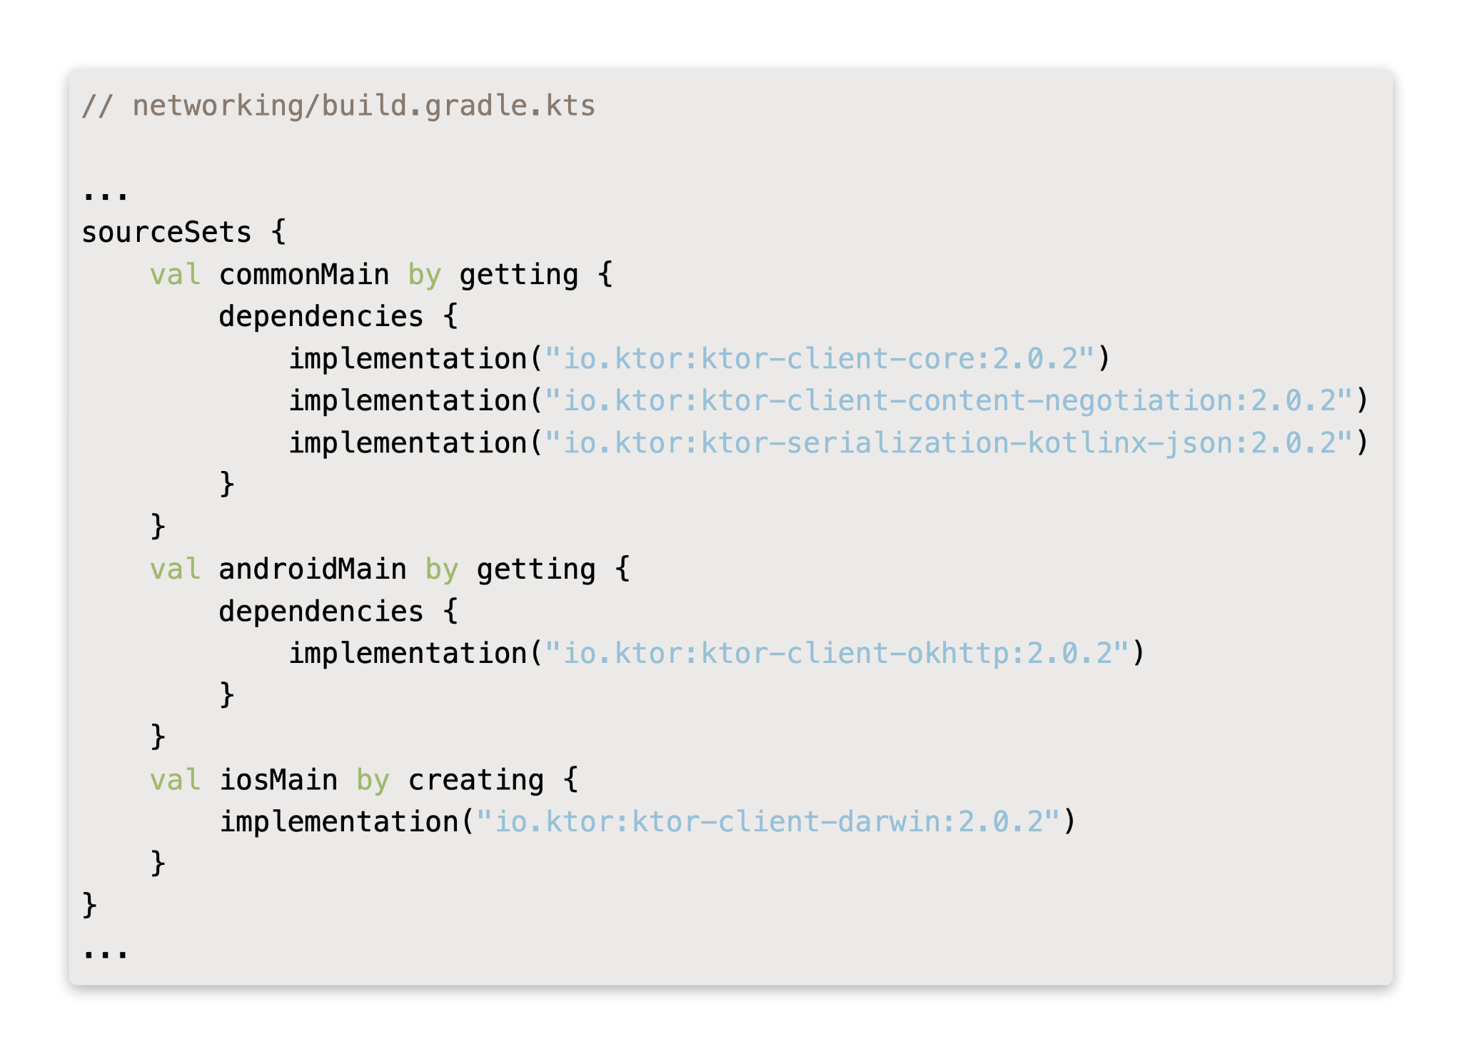
KTOR - Client
Add Dependencies

Slide 11
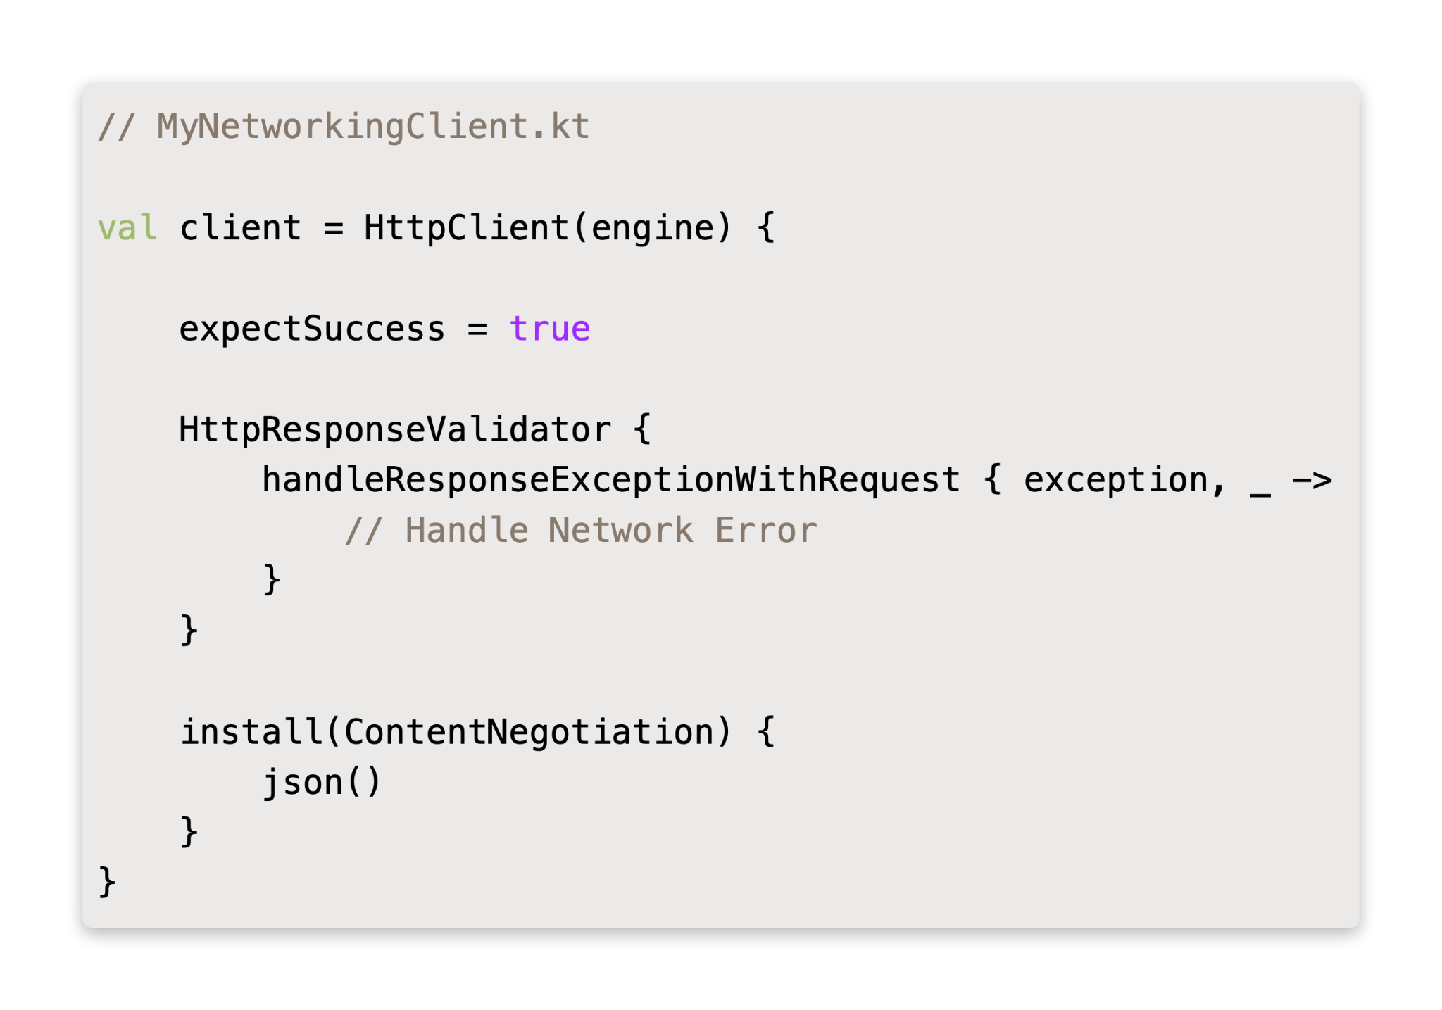
KTOR - Client
Initialize a networking client

Slide 12
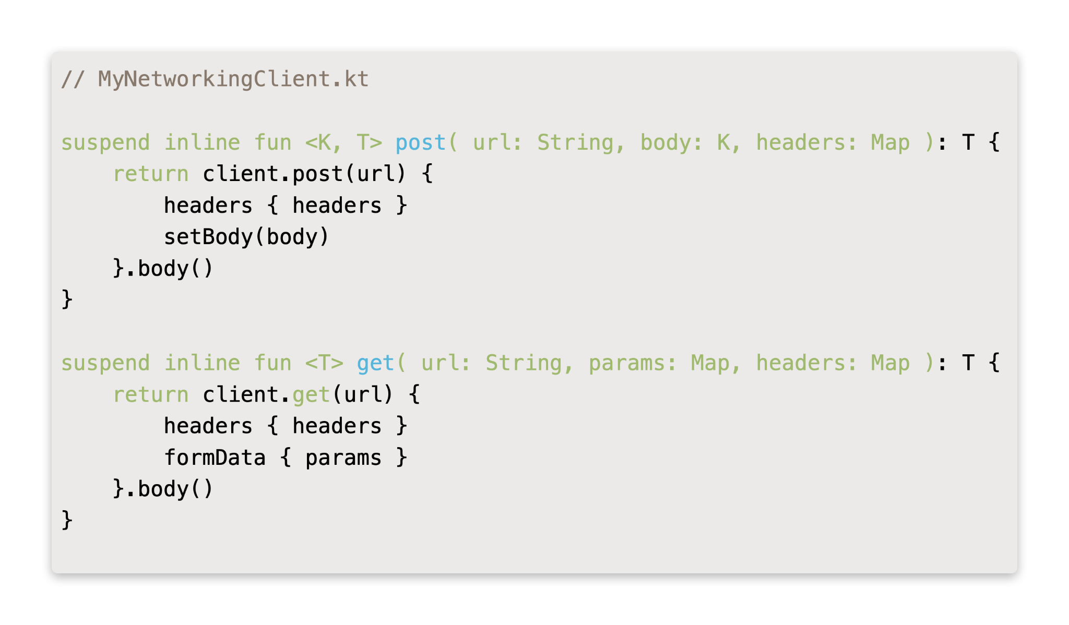
KTOR - Client
Set Up An `SDK`

Slide 13
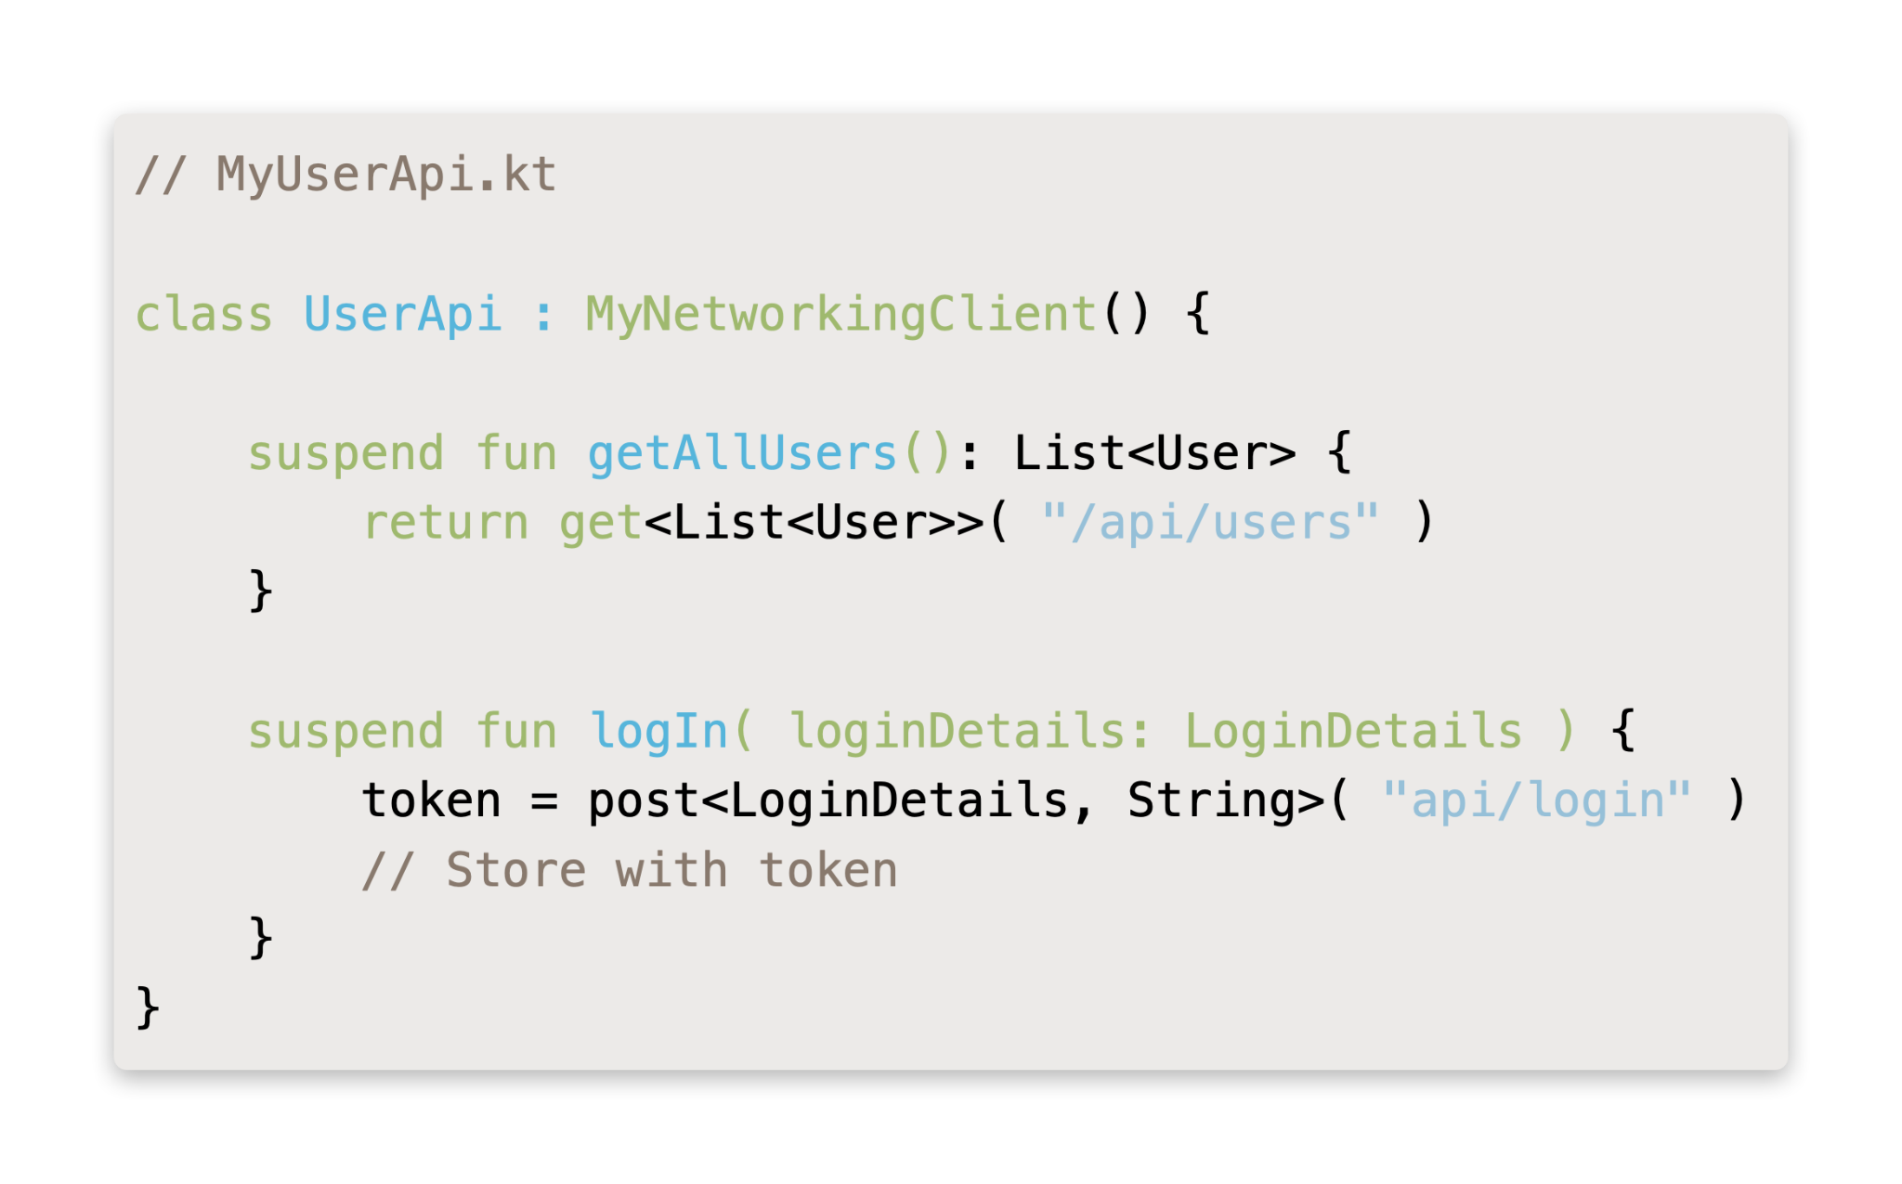
KTOR - Client
Make Network Requests

Slide 14
weuH..

Slide 15
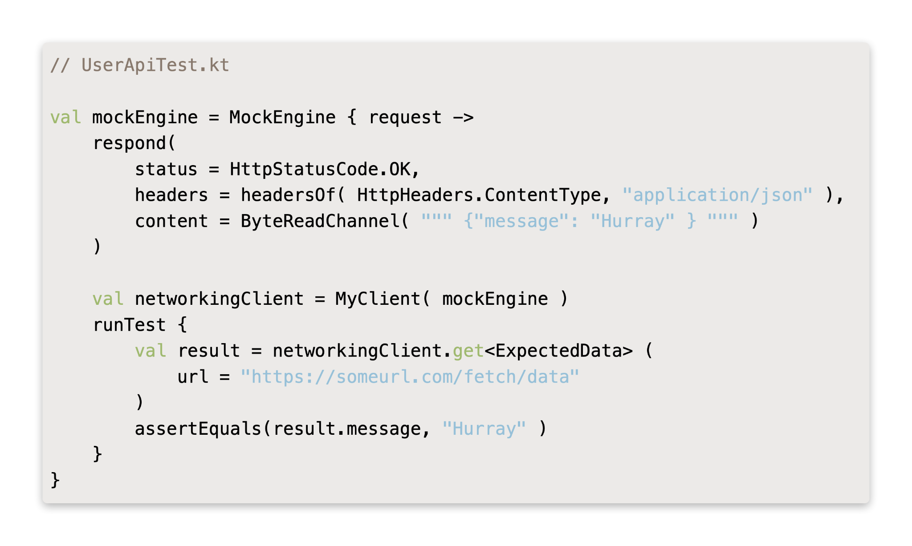
KTOR - Client
Testing Requests

Slide 16


Bye!!
* Code snippets provided in this presentation have been simplified for ease of understanding

